Slide 1
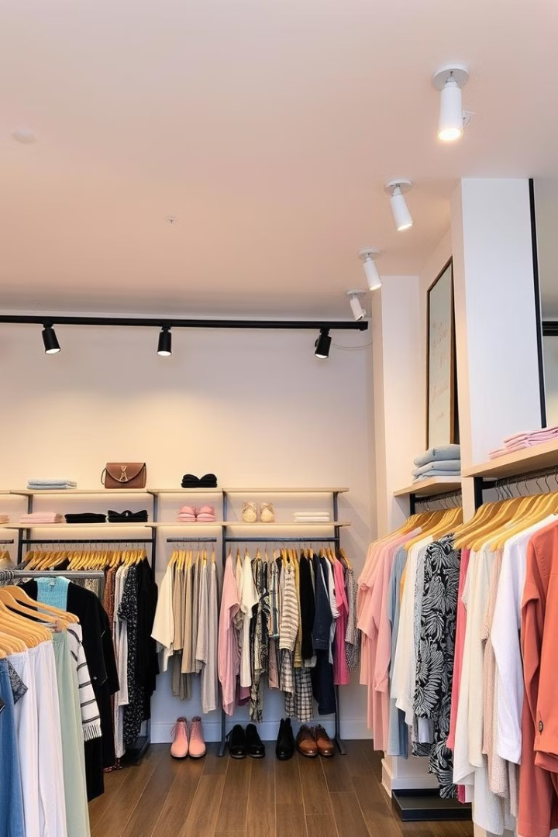
E-Commerce Website for Online Clothing Store:
This project involves developing an e-commerce website for an online clothing store that categorizes products by gender and size, providing a seamless shopping experience for customers.

Slide 2
Project Team:
Team Members
Group Leader
Areeza Iqbal (Roll# 24K-0854)
Armeen Azam (Roll# 24K-0654)
Laiba Jamil (Roll# 24K-0812)
Manahil Abbas (Roll# 24K-1026)
We got the idea for this project by observing the growing popularity of online shopping and identifying the challenges faced by users on existing platforms, such as cluttered interfaces and lack of straightforward categorization.
Inspired by the need for a simple yet efficient e-commerce solution, we decided to focus on a clothing store that organizes products by gender and size, ensuring an intuitive shopping experience.
Additionally, our interest in fashion and the opportunity to apply our web development knowledge in HTML and CSS motivated us to create a user-friendly platform tailored to customer needs.

Slide 3

Abstract:
1
Gender-Specific Categories:
2
Comprehensive Size Range:
3
Intuitive Navigation:
The website's user-friendly interface will allow customers to quickly find and purchase their desired clothing items.
The website will feature separate sections for Men's, Women's, and Children's clothing to cater to diverse customer preferences.
Customers will be able to easily browse and filter products based on Small, Medium, and Large sizes for a personalized shopping experience.

Slide 4

Key Features:
Men's Corner
Women's Boutique
Kids' Collection
Browse the latest styles for him, from casual tees to tailored suits.
Discover on-trend fashions that flatter every figure.
Outfit the whole family with our adorable children's line
.
Comprehensive Size Range
Responsive Design
Customers will be able to filter and sort products by Small, Medium, and Large sizes to ensure a perfect fit.
The website will be optimized for seamless browsing and shopping experiences across desktop, tablet, and mobile devices.
Secure Checkout
Customers will have access to a safe and reliable checkout process, ensuring the protection of their personal and financial information.

Slide 5

User Interface Design
Homepage
Product Details
The homepage will feature a visually appealing layout showcasing the latest clothing collections and featured products.
Detailed product information, including images, descriptions, sizes, and pricing, will be provided to assist customers in their purchasing decisions.
1
2
3
Category Pages
Customers will be able to easily navigate through the Men's, Women's, and Children's clothing sections to find their desired products.

Slide 6
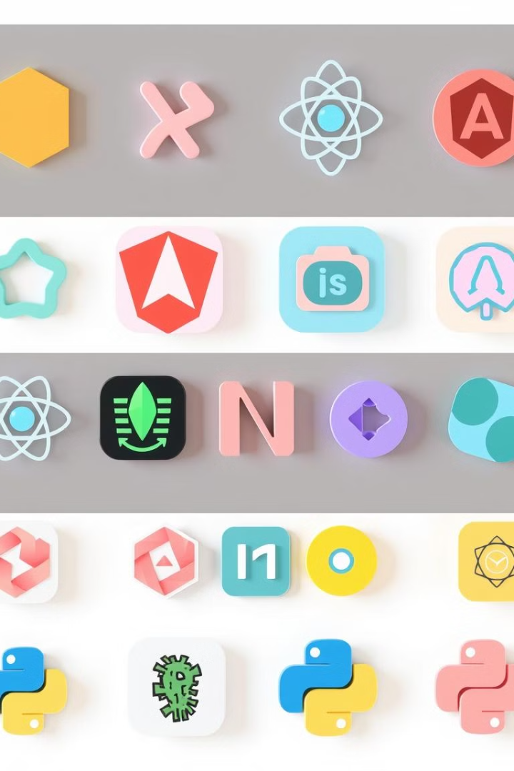


Technology Stack:
HTML
CSS
Structured markup for the website's content and layout.
Styling and visual presentation of the website.

Slide 7




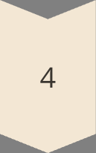
Project Timeline:
Planning:
Defining the project scope, requirements, and design.
Development :
Implementing the website's features and functionality.
Testing :
Ensuring the website's usability, performance, and stability.
Development :
Launching the e-commerce website for public access.

Slide 8

Conclusion :
1
Seamless Shopping Experience:
2
Increased Customer Satisfaction:
The e-commerce website will provide customers with a streamlined and enjoyable shopping experience, catering to their clothing preferences and size requirements.
By offering a wide range of clothing options, secure transactions, and responsive design, the website aims to enhance customer satisfaction and loyalty.
3
Business Growth Potential:
The comprehensive e-commerce solution will enable the online clothing store to expand its reach, increase sales, and establish a strong online presence in the competitive market.

